Slide 1

More info at www.meetup.com/Boston-useR
Notes:
Regular meetups
#TidyTuesday is a weekly data project aimed at the R ecosystem (see info below). An emphasis is placed on understanding how to summarize and arrange data to make meaningful charts with ggplot2, tidyr, dplyr, and other tools in the tidyverse ecosystem.

Slide 2
Variance and Overdispersion
Eric Scott

Slide 3
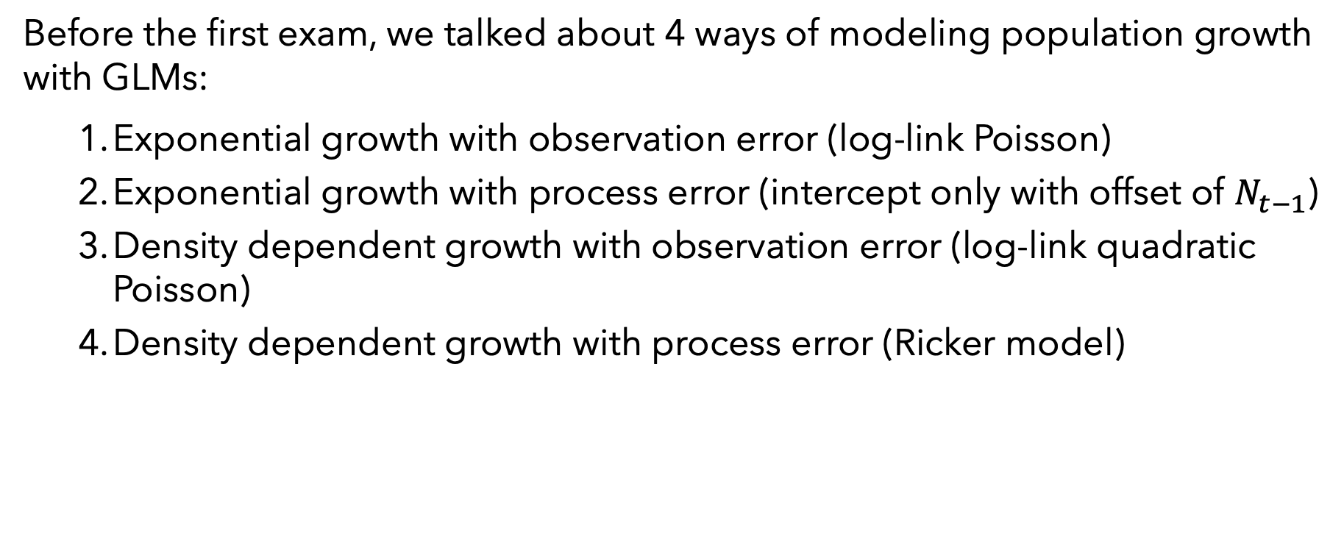
Last time
Before the first exam, we talked about 4 ways of modeling population growth with GLMs:
Exponential growth with observation error (log-link Poisson)
Exponential growth with process error (intercept only with offset of $N_{t−1}$)
Density dependent growth with observation error (log-link quadratic Poisson)
Density dependent growth with process error (Ricker model)

Slide 4

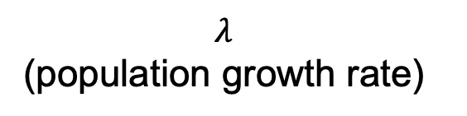

Interpreting parameters
m1 <- glm(num.wolves ~ year_post, family = poisson(link = "identity"), data = wolves_sub) coef(m1)
## (Intercept) year_post ## -1002.23754 82.79097
m1b <- glm(num.wolves ~ year_post, family = poisson(link = "log"), data = wolves_sub) exp(coef(m1b))
## (Intercept) year_post ## 10.674835 1.223248
$${N_{T}=N}_{0}+β_{1}T$$
change in number of wolves/year (slope)
$$N_{T}=λ^{T}N_{0}$$
$λ$
(population growth rate)

Slide 5
Interpreting parameters
m1 <- glm(num.wolves ~ year_post, family = poisson(link = "identity"), data = wolves_sub) coef(m1)
## (Intercept) year_post ## -1002.23754 82.79097
m1b <- glm(num.wolves ~ year_post, family = poisson(link = "log"), data = wolves_sub) exp(coef(m1b))
## (Intercept) year_post ## 10.674835 1.223248
$${N_{T}=N}_{0}+β_{1}T$$
change in number of wolves/year
$$N_{T}=λ^{T}N_{0}$$
$λ$
(population growth rate)
Fitting a line to data: ${y=β}_{0}+β_{1}x$

Slide 6
Interpreting parameters
m1 <- glm(num.wolves ~ year_post, family = poisson(link = "identity"), data = wolves_sub) coef(m1)
## (Intercept) year_post ## -1002.23754 82.79097
m1b <- glm(num.wolves ~ year_post, family = poisson(link = "log"), data = wolves_sub) exp(coef(m1b))
## (Intercept) year_post ## 10.674835 1.223248
$${N_{T}=N}_{0}+β_{1}T$$
change in number of wolves/year
$$N_{T}=λ^{T}N_{0}$$
$λ$
(population growth rate)
Fitting a line to data: ${y=β}_{0}+β_{1}x$

Slide 7

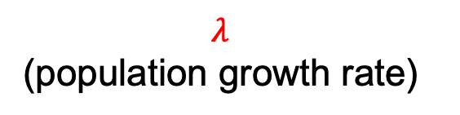

Interpreting parameters
m1 <- glm(num.wolves ~ year_post, family = poisson(link = "identity"), data = wolves_sub) coef(m1)
## (Intercept) year_post ## -1002.23754 82.79097
m1b <- glm(num.wolves ~ year_post, family = poisson(link = "log"), data = wolves_sub) exp(coef(m1b))
## (Intercept) year_post ## 10.674835 1.223248
$${N_{T}=N}_{0}+β_{1}T$$
change in number of wolves/year
$$N_{T}=λ^{T}N_{0}$$
$λ$
(population growth rate)
Statistical distribution: ${\text{E}\left(Y_{i}\right)=β}_{0}+β_{1}x_{i}$
$Y_{i}\sim \text{Poisson}\text{(}λ)$
$λ$ ≠ $λ$

Slide 8
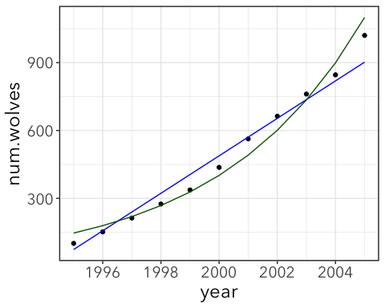
Link functions change the shape of the line
Similar to transforming data, but rather than transforming response variable from raw data, transforms expected values

Slide 9
Observation vs. Process error
Observation error models:
Assume all error due to sampling process
Error only effects current observed state of the population
Uses a formula to calculate a curve over time
Works with missing years of data
Process error models:
Assumes there is year-to-year variation in the true population size
“Error” feeds back to affect the future state of the population
Predicted counts are some function of count from previous time step
Makes sense when counts are exact (e.g. small or lab population)
Doesn’t work with missing data

Slide 10
End of recap…

Slide 11
Variance and mixture models

Slide 12
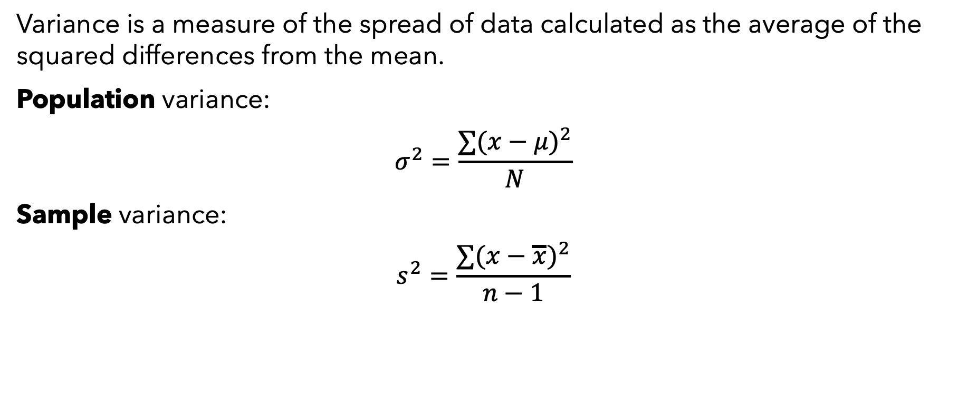
Variance
Variance is a measure of the spread of data calculated as the average of the squared differences from the mean.
Population variance:
$$σ^{2}=\frac{∑(x−μ)^{2}}{N}$$
Sample variance:
$$s^{2}=\frac{∑(x−\overline{x})^{2}}{n−1}$$

Slide 13
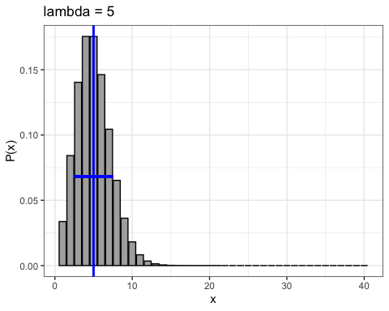
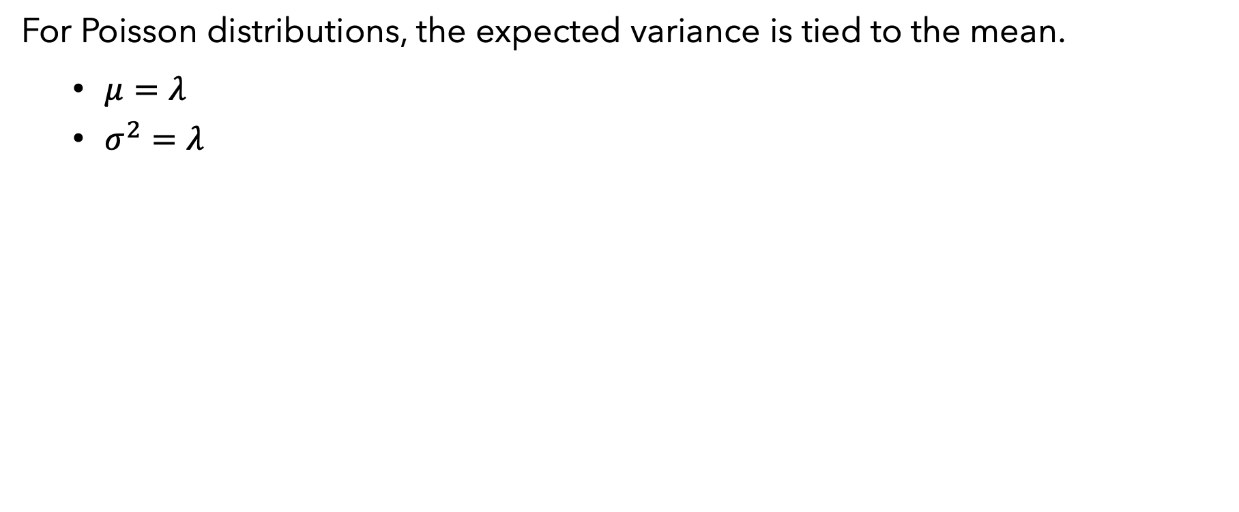
Poisson variance
For Poisson distributions, the expected variance is tied to the mean.
$μ=λ$
$σ^{2}=λ$

Slide 14
Sample variance
You can calculate the sample variance of your actual data with the var() function in R
x <- rpois(1000, 5)
var(x)
## [1] 4.672263
What does this line do?

Slide 15
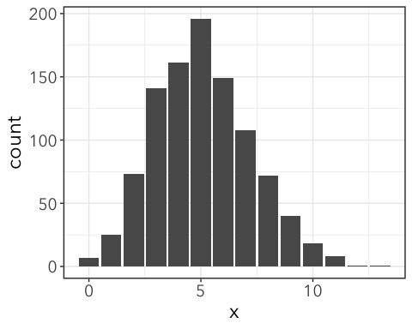
ggplot(tibble(x), aes(x)) + geom_bar()

Slide 16
GLMs partition variance
What if our data comes not from one population with a Poisson distribution, but two Poisson distributed populations with different means?
#simulated data that is combination of two poisson distributions. y1 <- rpois(500, 3) y2 <- rpois(500, 10) mean(c(y1, y2))
## [1] 6.472
var(c(y1, y2))
## [1] 18.80802
Now, there is more variation than we would predict from a simple Poisson process.

Slide 17
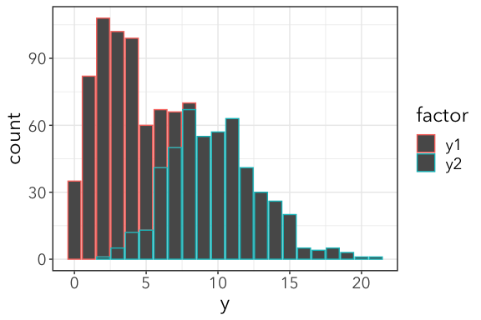

Slide 18
GLMs partition variance
If we fit a model that accounts for differences among levels of factor, we can account for the increased variance.
m <- glm(y ~ factor, family = poisson(link = "identity"), data = data2)
To see this, we need to look at the residuals (AKA “errors”)

Slide 19
Working with Residuals
Residuals (aka “errors”) are the difference between the data points and the expected/fitted values from a model.
m <- glm(y ~ sample, family = poisson(link = "identity"), data = data2) augmented <- data2 %>% mutate(fitted = predict(m, type = "response")) %>% mutate(residuals = y - fitted) head(augmented)
## # A tibble: 6 x 4 ## sample y fitted residuals ## <chr> <int> <dbl> <dbl> ## 1 y1 1 3.01 -2.01 ## 2 y2 13 9.94 3.06 ## 3 y1 2 3.01 -1.01 ## 4 y2 6 9.94 -3.94
Shortcut:
residuals(m, type = “response”)

Slide 20
Checking residuals
Variance of residuals (after accounting for differences among levels in ”factor”) meet Poisson assumptions.
residuals(m, type = "response") %>% var()
## [1] 6.782843
mean(c(y1,y2))
## [1] 6.472
Residual variance > mean = overdispersed.
Residual variance < mean = underdispersed

Slide 21
Deviance
More commonly, deviance of a Poisson GLM is used to check for overdispersion.
Model deviance should be about the same as residual degrees of freedom.
deviance(m) / df.residual(m)
## [1] 1.068471
If greater than 1, overdispersion. If less than 1, underdispersion.
Formal test for overdispersion:
pchisq(deviance(m), df.residual(m), lower.tail = FALSE)
## [1] 0.06542258
p > 0.05, so not overdispersed
Notes:
Maybe add formula for deviance?

Slide 22
What if we can’t account for departures from error family?
Example:
df2 <- tibble(y = c(rpois(20, 4), rpois(20, 50), rpois(20, 200)), #factor levels are random, don't correspond to three distributions factor = sample(c("A", "B", "C", "D"), 60, replace = TRUE)) head(df2)
## # A tibble: 6 x 2 ## y factor ## <int> <chr> ## 1 5 D ## 2 4 C ## 3 7 A m2 <- glm(y~factor, family = poisson(), data = df2) deviance(m2) / df.residual(m2)
## [1] 89.65786
Overdispersed!

Slide 23

summary(m2) ## Call: ## glm(formula = y ~ factor, family = poisson(), data = df2) ## ## Deviance Residuals: ## Min 1Q Median 3Q Max ## -13.872 -10.100 -4.699 9.168 13.213 ## ## Coefficients: ## Estimate Std. Error z value Pr(>|z|) ## (Intercept) 4.36276 0.02590 168.461 < 2e-16 *** ## factorB 0.26057 0.03859 6.753 1.45e-11 *** ## factorC 0.21023 0.03913 5.372 7.77e-08 *** ## factorD -0.13722 0.03912 -3.507 0.000452 *** ## --- ## Signif. codes: 0 '***' 0.001 '**' 0.01 '*' 0.05 '.' 0.1 ' ' 1 ## ## (Dispersion parameter for poisson family taken to be 1) ## ## Null deviance: 5356.0 on 59 degrees of freedom ## Residual deviance: 5231.4 on 56 degrees of freedom ## AIC: 5558.2 ## ## Number of Fisher Scoring iterations: 6
These are not the P-values you are looking for.
Notes:
If residual deviance >> DF, then overdispersed

Slide 24

Consequences:
If residuals don’t meet assumptions (e.g. overdispersion), p-values are unreliable.
Just look, this meaningless factor gives a highly significant p-value! But don’t trust it!
m0 <- glm(y ~ 1, family = poisson(), data = df2) lmtest::lrtest(m0, m2)
## Likelihood ratio test ## ## Model 1: y ~ 1 ## Model 2: y ~ factor ## #Df LogLik Df Chisq Pr(>Chisq) ## 1 1 -2924.4 ## 2 4 -2670.6 3 507.65 < 2.2e-16 *** ## --- ## Signif. codes: 0 '***' 0.001 '**' 0.01 '*' 0.05 '.' 0.1 ' ' 1
Levels totally randomized with respect to data!
Untrustworthy!

Slide 25

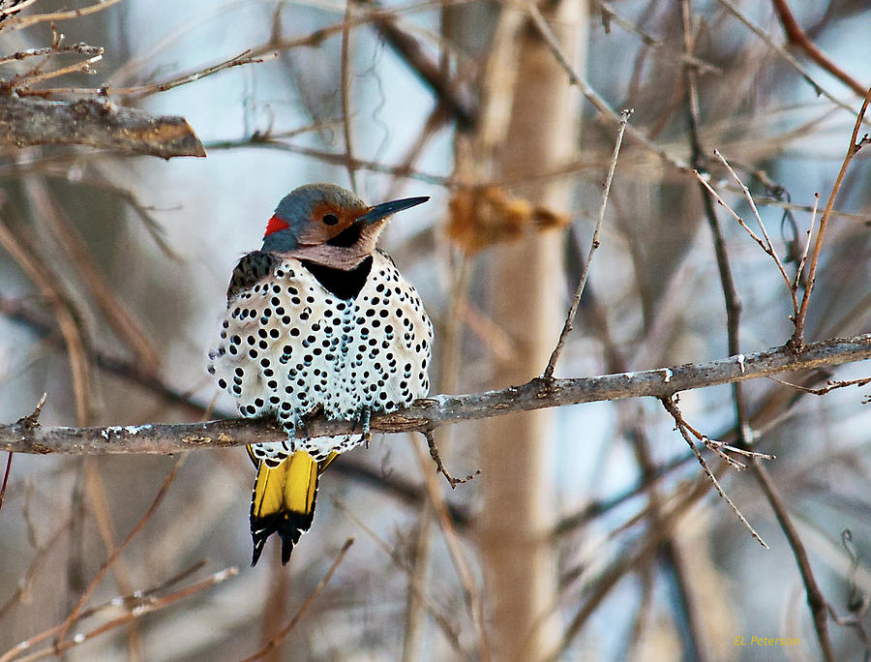
www.christmasbirdcount.org

Slide 26
Poisson assumption: all sites identical
probability of seeing birds per area is constant
125 birds, randomly located in 25 km² landscape:
Counts per sq km:
4 | 5 | 7 | 4 | 4
4 | 4 | 8 | 7 | 6
5 | 4 | 9 | 7 | 5
6 | 6 | 2 | 5 | 4
3 | 3 | 5 | 2 | 5

Slide 27
Many possible random configurations
If locations are independent, mean count will be 5 and variance will be 5
Overdispersion: variance higher than expected (birds are clumped)
Underdispersed: variance lower than expected (birds are stratified)

Slide 28
Poisson distribution – uniform habitat quality
sampling variance in counts…
= 5.0
σ² = 5.0

Slide 29
What if only 75% of sites are suitable habitat?
….Counts will have too many 0’s for a Poisson distribution
BUT not all 0’s are unsuitable habitat (some are Poisson variation)

Slide 30
Zero-inflated Poisson
Parameters: p, Bernoulli probability of 0
λ, Poisson rate parameter
Mean:
Variance:
Minimum: 0
Maximum:∞
Application: Product of two processes, one Bernoulli and one Poisson
“mixture model”

Slide 31
Zero-inflated models: binomial + Poisson “mixture model”
Two categories of data (example):
Species present – counts follow a Poisson distribution
Species absent – there are no animals
Notes:
Uniform sampling – same number of samples per group

Slide 32
Zero-inflated models: binomial + Poisson “mixture model”
Two categories of data (example):
Species present – counts follow a Poisson distribution
Species absent – there are no animals
Likelihood function has 2 parameters:
1. Probability that each site is unsuitable, p
What is the probability of seeing 0 animals?
P(site is unsuitable)+P(site is suitable)P(seeing 0 animals)
Notes:
Uniform sampling – same number of samples per group

Slide 33
Zero-inflated models: binomial + Poisson “mixture model”
Two categories of data (example):
Species present – counts follow a Poisson distribution
Species absent – there are no animals
Likelihood function has 2 parameters:
1. Probability that each site is unsuitable, p
What is the probability of seeing 0 animals?
P(site is unsuitable)+P(site is suitable)P(seeing 0 animals)
Notes:
Uniform sampling – same number of samples per group

Slide 34
Zero-inflated models: binomial + Poisson “mixture model”
Two categories of data (example):
Species present – counts follow a Poisson distribution
Species absent – there are no animals
Likelihood function has 2 parameters:
1. Probability that each site is unsuitable, p
2. Average count of animals if a site is suitable, λ
What is P(seeing some number, k > 0?)
P(site is suitable and count = k)
Notes:
Uniform sampling – same number of samples per group

Slide 35
Zero-inflated Poisson
= 3.8
σ² =8.4
Binomial
Poisson
ZiP
“OR” rule

Slide 36
Zero-inflated Poisson (ZiP) PDF
Probability density function of the mixture model:

Slide 37
# of sites
# birds/site
www.christmasbirdcount.org

Slide 38
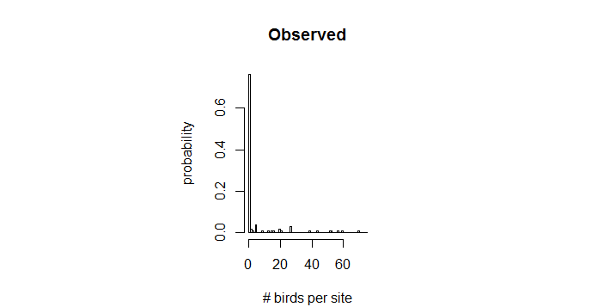
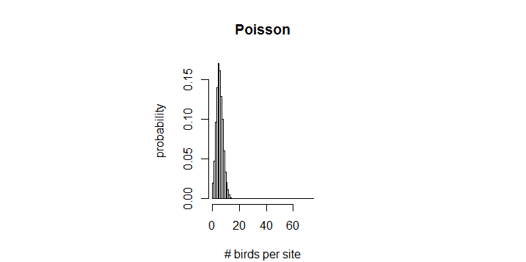
mean = 5.86
variance = 212.77
mean = 5.86
variance = 5.86
Notes:
Definitely not just
poisson!

Slide 39
Fitting ZiP models
The pscl package provideds the zeroinfl() function that works similarly to glm()
library(pscl)
m2 <- zeroinfl(Count ~ 1, data = birds) m2 ## Call: ## zeroinfl(formula = Count ~ 1, data = birds) ## ## Count model coefficients (poisson with log link): ## (Intercept) ## 3.175 ## ## Zero-inflation model coefficients (binomial with logit link): ## (Intercept) ## 1.125
Expected # | suitable
(log link)
Probability of being unsuitable
(logit link)

Slide 40
summary(m2) ## Call: ## zeroinfl(formula = Count ~ 1, data = birds) ## ## Pearson residuals: ## Min 1Q Median 3Q Max ## -0.5547 -0.5547 -0.5547 -0.5547 6.0678 ## ## Count model coefficients (poisson with log link): ## Estimate Std. Error z value Pr(>|z|) ## (Intercept) 3.17471 0.04089 77.64 <2e-16 *** ## ## Zero-inflation model coefficients (binomial with logit link): ## Estimate Std. Error z value Pr(>|z|) ## (Intercept) 1.1249 0.2302 4.887 1.02e-06 *** ## --- ## Signif. codes: 0 '***' 0.001 '**' 0.01 '*' 0.05 '.' 0.1 ' ' 1 ## ## Number of iterations in BFGS optimization: 11 ## Log-likelihood: -340.4 on 2 Df
These are not the P-values you are looking for.
Notes:
P-values provided in summary() are always just testing if estimate differs significantly from zero. What we want is a likelihood ratio test or AIC comparison.

Slide 41
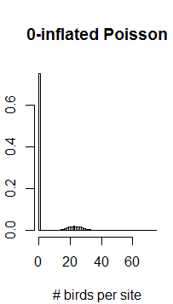
mean = 5.86
variance = 212.77
mean = 5.86
variance = 5.86
mean = 5.99
variance = 113.55

Slide 42
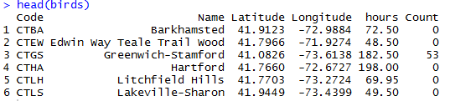
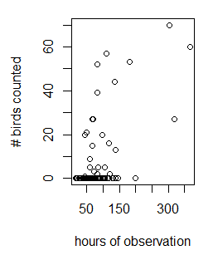

Slide 43
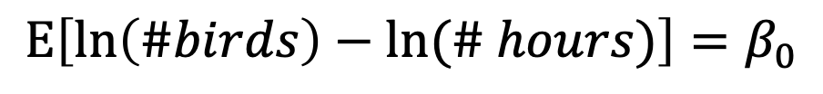
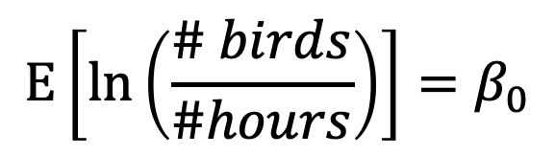
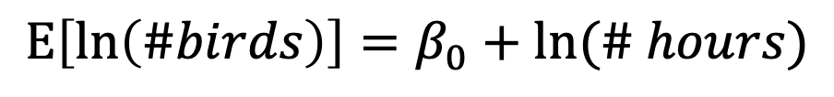
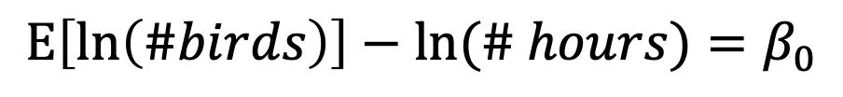
$$E\left[ln\left(\frac{\# birds}{\#hours}\right)\right]=β_{0}$$
$$E\left[ln\left(\#birds\right)−ln⁡(\# hours)\right]=β_{0}$$
$$E\left[ln\left(\#birds\right)\right]−ln⁡(\# hours)=β_{0}$$
$$E\left[ln\left(\#birds\right)\right]=β_{0}+ln⁡(\# hours)$$
zeroinfl(Count~ 1, offset = log(hours))
Note: pscl applies offset to count model only

Slide 44
ZiP with offset
m3 <- zeroinfl(Count ~ 1, offset = log(hours), data = birds) m3 ## Call: ## zeroinfl(formula = Count ~ 1, data = birds, offset = log(hours)) ## ## Count model coefficients (poisson with log link): ## (Intercept) ## -1.583 ## ## Zero-inflation model coefficients (binomial with logit link): ## (Intercept) ## 1.123
Expected # per hour | suitable
(log link)
Probability of being unsuitable
(logit link)

Slide 45
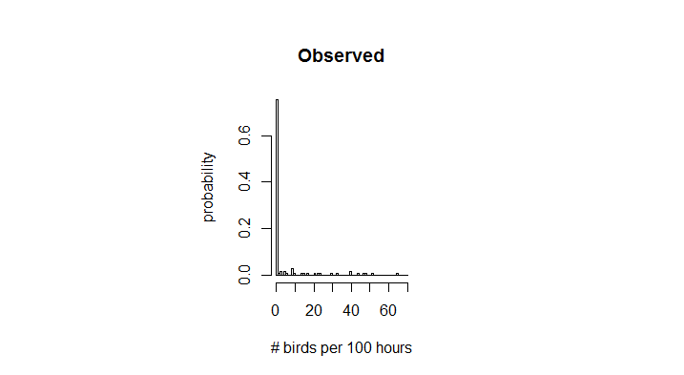

mean = 5.5
variance = 174.2
mean = 5.1
variance = 84.4

Slide 46
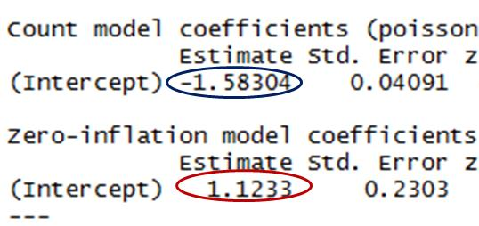
P[unsuitable], p
= inverse logit of 1.1233 = 0.755
E[count/hour|suitable], λ
= exp(-1.58304) = 0.205
Expected count/hour =
P[suitable] x E[count|suitable]
= (1-0.755)×0.205 = 0.0504
mean = 5.1
variance = 84.4

